Slide 1
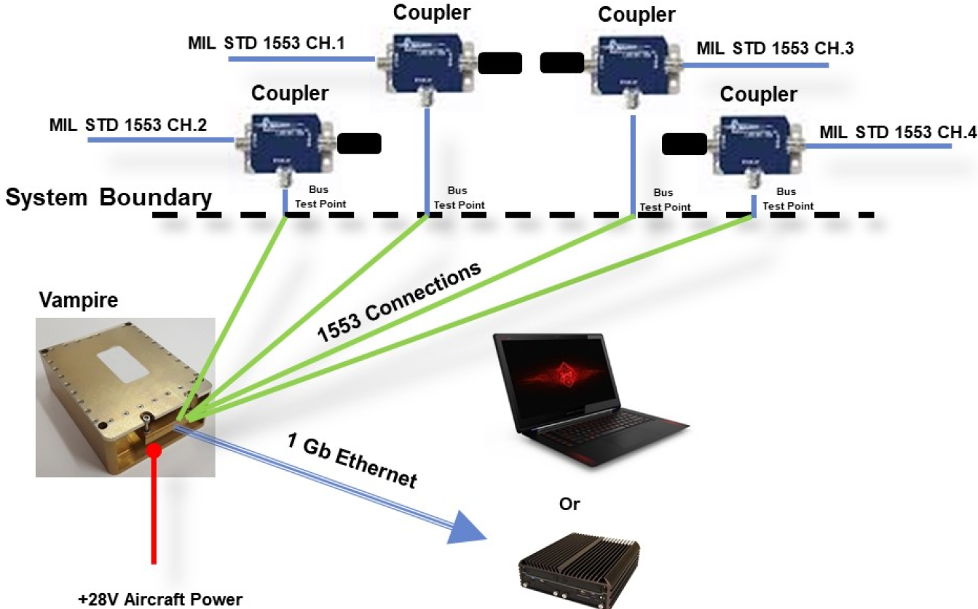
Vibrant Collaboration via N-FACTOR
The National Federation of Aviation Cyber Test Organizations and Researchers (N-FACTOR)
VIBRANT is being used as an N-FACTOR pilot to support collaboration efforts with the AFRL VAMPIRE 1553 bus adaptor tool,
We are also in the process of linking in JH APL for data to support AI/ML training and testing, and
We have 10 heavy-weight organizations from DoD, interagency, Academia (UARCS), FFRDCs, and industry teaming this to move it to execution.
Purpose:
1. Identify, catalog and share National Aviation cyber test and experimentation resources and expertise,
2. Identify and address testing capability shortfalls, and
3. Collaborate on aviation cyber initiatives.
We are using our SBIR VIBRANT project as a pilot to show how the N-FACTOR can advance innovation, especially in support of smaller companies.
VIBRANT Dev.
VIBRANT Prod.

