Slide 1
Securboration Technology Conference BA&DT
15 Nov 2022

Slide 2
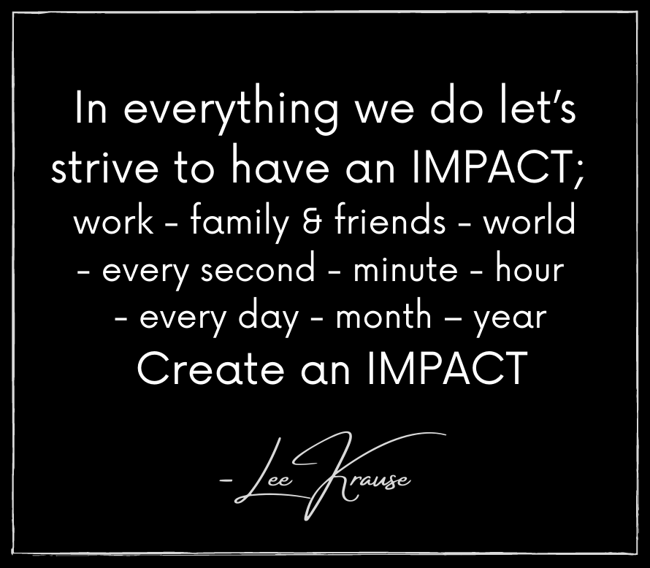
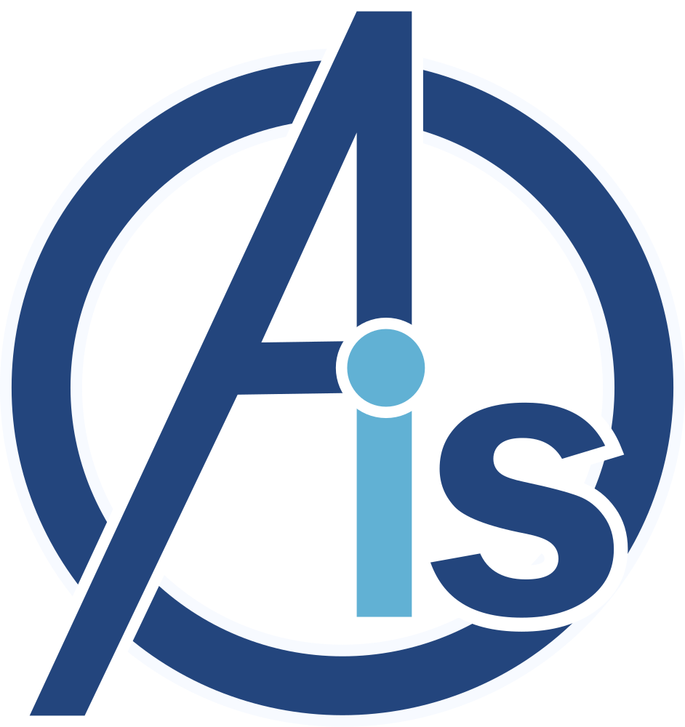
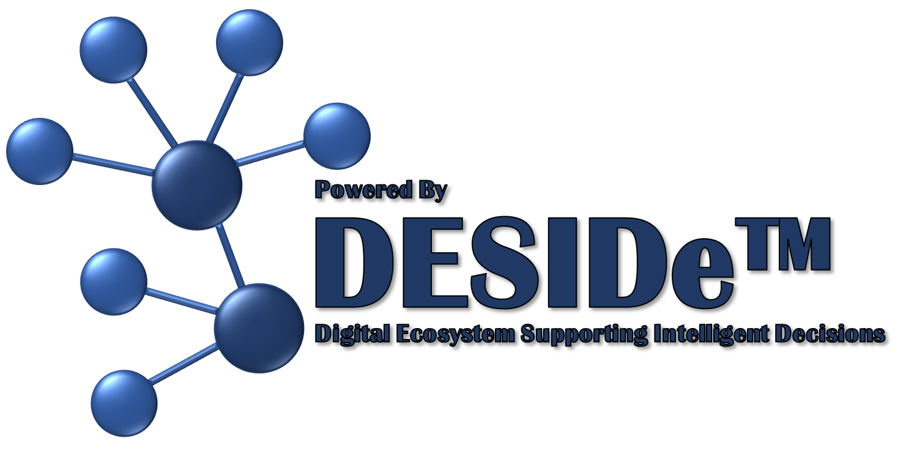

Slide 3
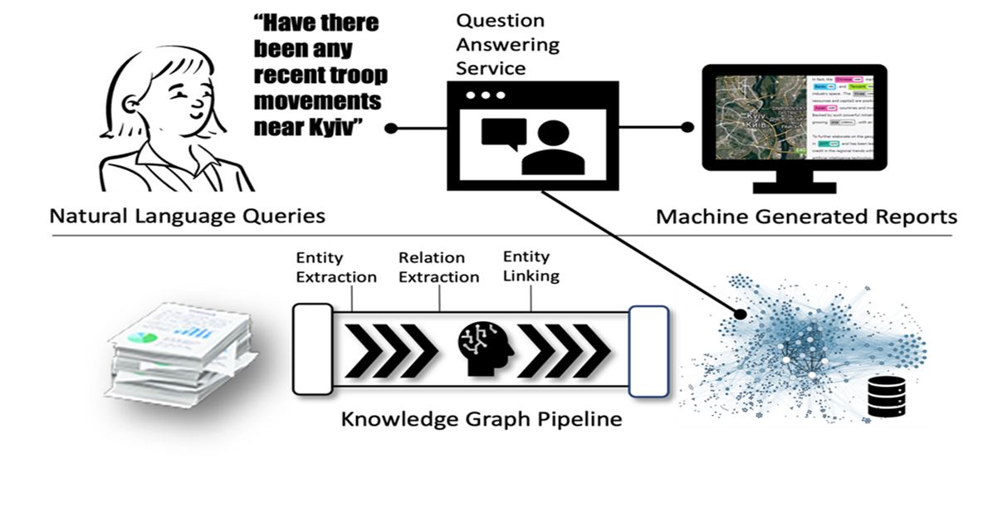
BA&DT - Business Analytics & Digital Transformation
Focus on early research and technology development to enable the
Digital Transformation of organizational processes across the Program Life Cycle.

Slide 4
What is our products IMPACT?
Innovation | Develop ideas and programs that impact the customer | Leveraging latest Ontological and Semantic Analysis related technologies to address DoD Acquisition Processes, knowledge sharing, and aircraft maintenance.
Mission | Understanding the customer's mission or problem | Improve the quality of decision-making by DoD Acquisition Professionals in a digital world.
Performance | Exceed our customer's expectations | Improve productivity for creating DoD Acquisition related data products and performing aircraft maintenance operations.
Accelerate | Propel the speed of development/innovation | Focus on developing the collaborative environment that allows the User to create content that can be easily shared with others within and across organizations.
Cost | Do more with less, be mindful of cost | Reduce the Cost of the DoD Acquisition process and improve program decision making across the entire Program Lifecycle.
Transition | Our customers immediately leverage our solutions and see the impact | Working closely with WR-ALC for aircraft maintenance related applications as well as DAF DTO and USSF for DoD Acquisition related applications.

Slide 5
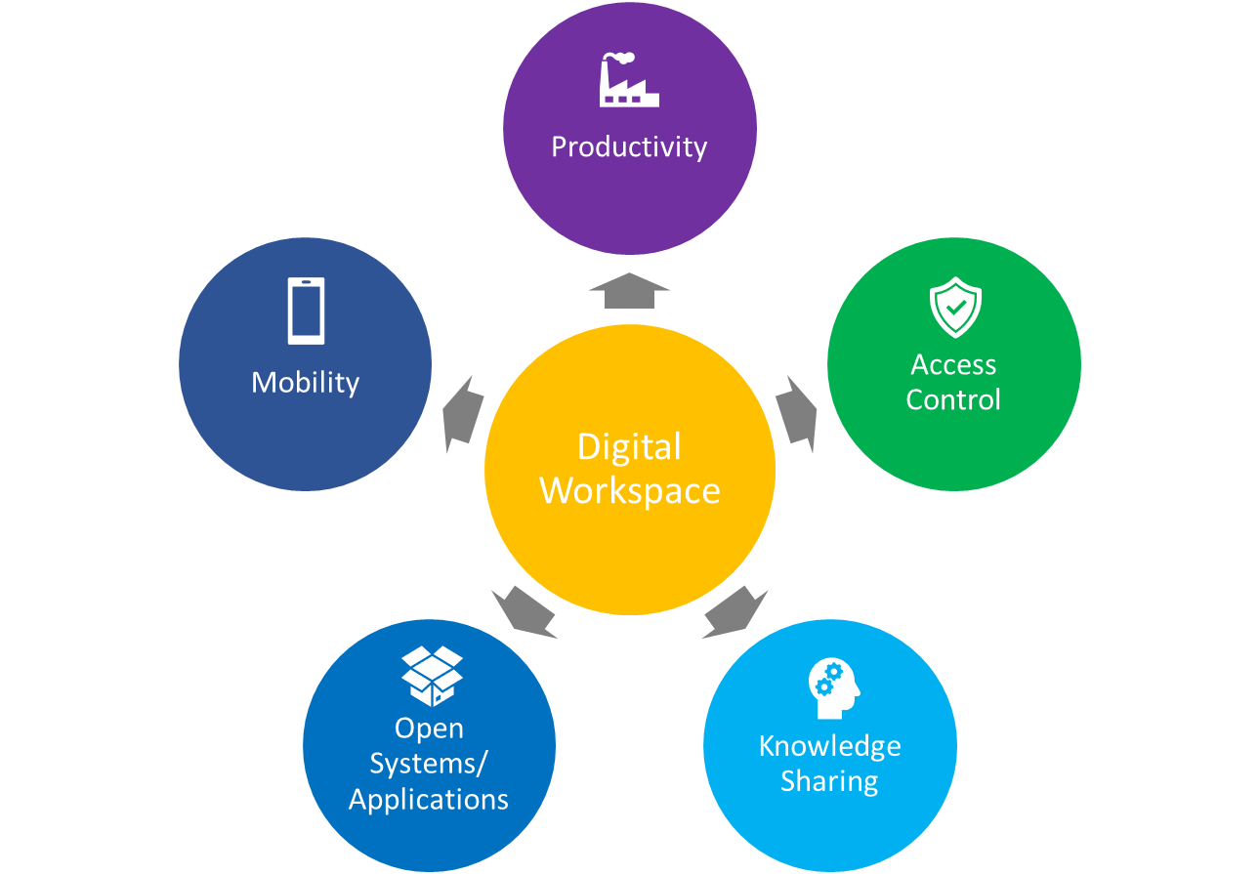
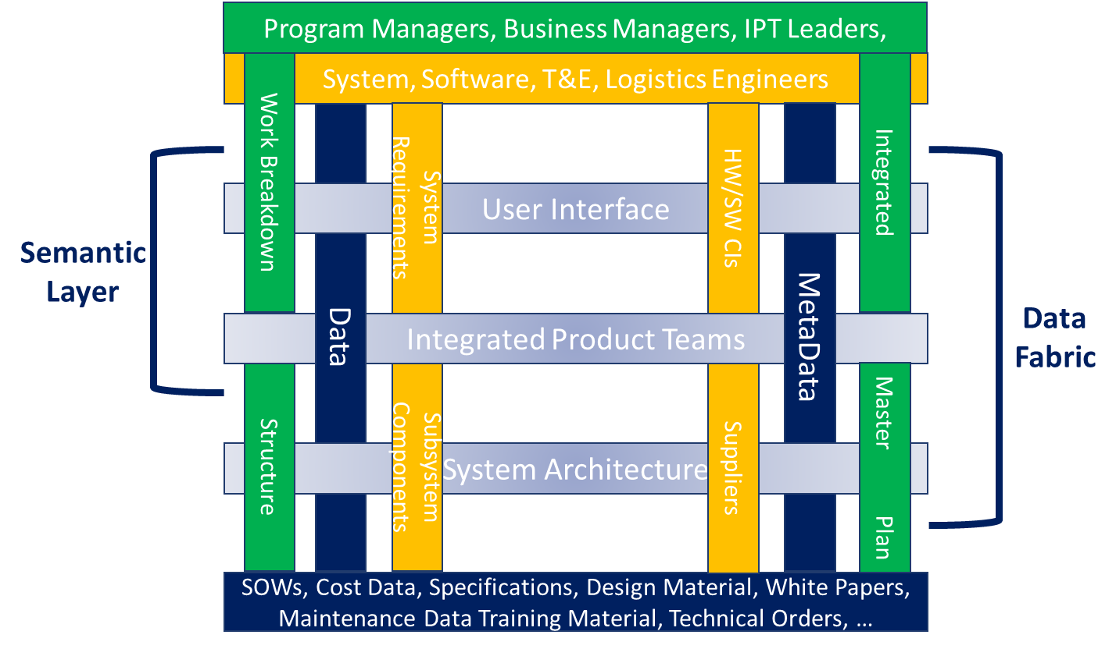
Innovation
The BA&DT Team is focused on applying Digital Transformational technologies like
Ontologies
Semantic Analysis
Digital Threads
Digital Models
To Customer processes (DoD Acquisition, DTIC/RTCA knowledge sharing, military and commercial aircraft/commodities maintenance, …) across organizational boundaries throughout the entire Program Lifecycle.

Slide 6
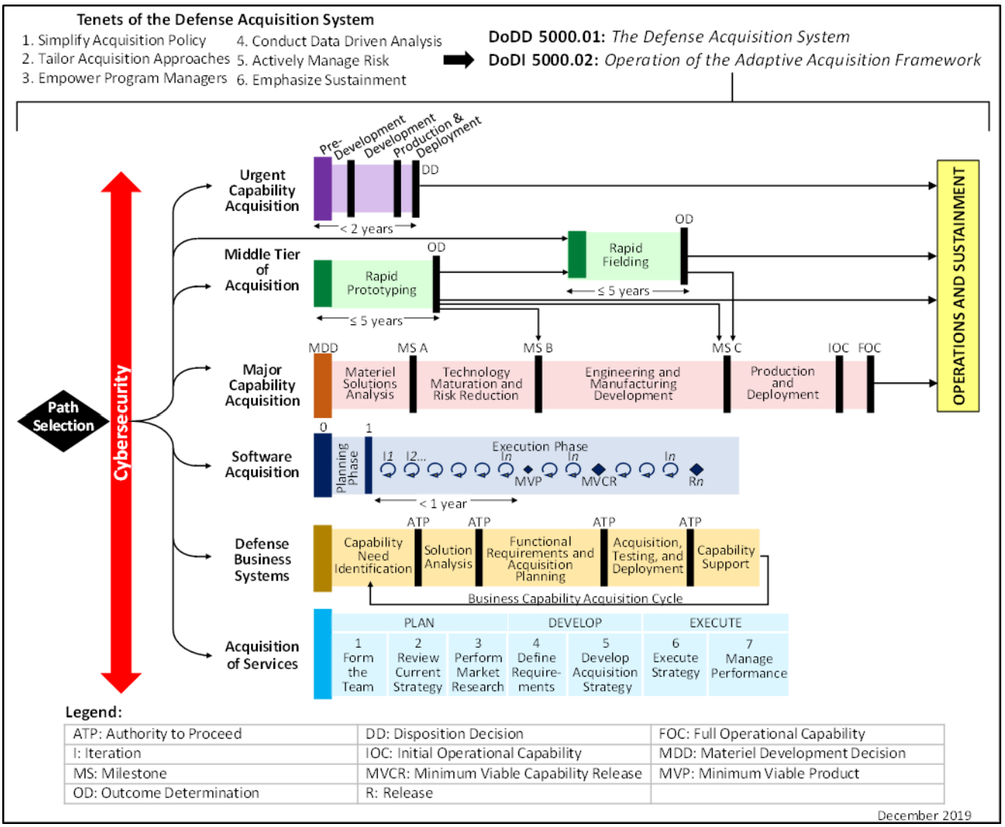
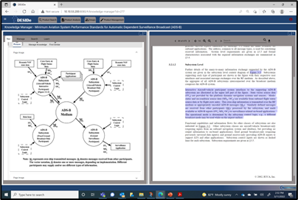
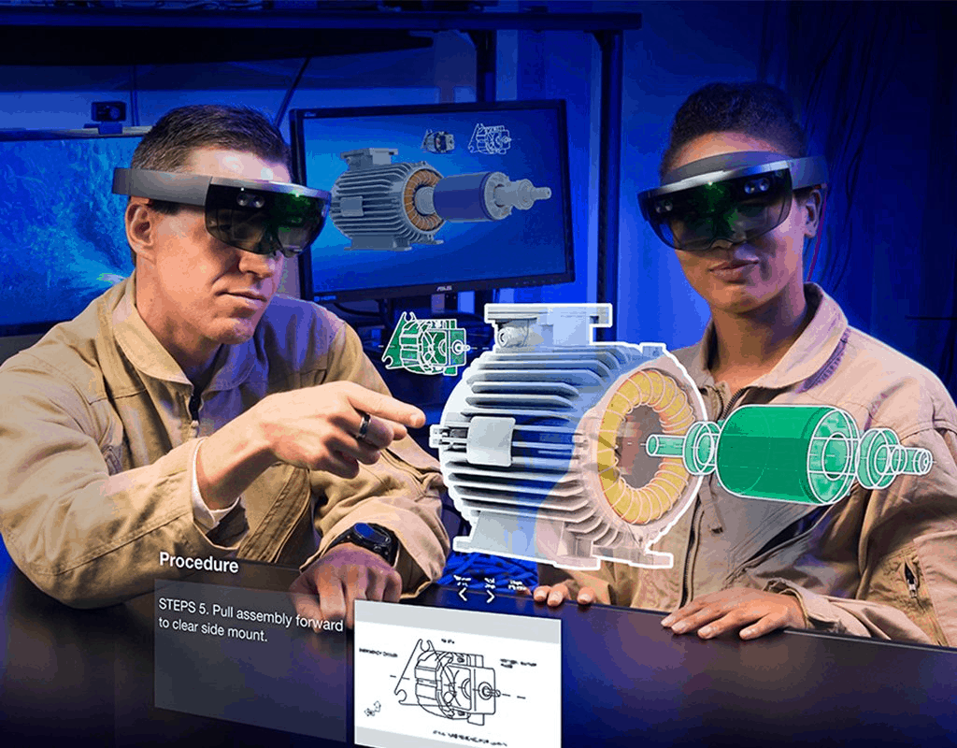
Mission
The BA&DT Team’s Mission is to improve the quality of decision-making for
DoD Acquisition professionals in a digital world
DTIC/RTCA sharing knowledge of controlled documents and reports
Military and commercial aircraft/commodities maintenance

Slide 7
Performance
By improving the tools available to the Warfighter (in this case Acquisition Professionals), significant improvements can be made to the cost and schedule associated with administrative elements of program execution from RFP/Proposal thru Program Execution to Operations and Sustainment.

Slide 8
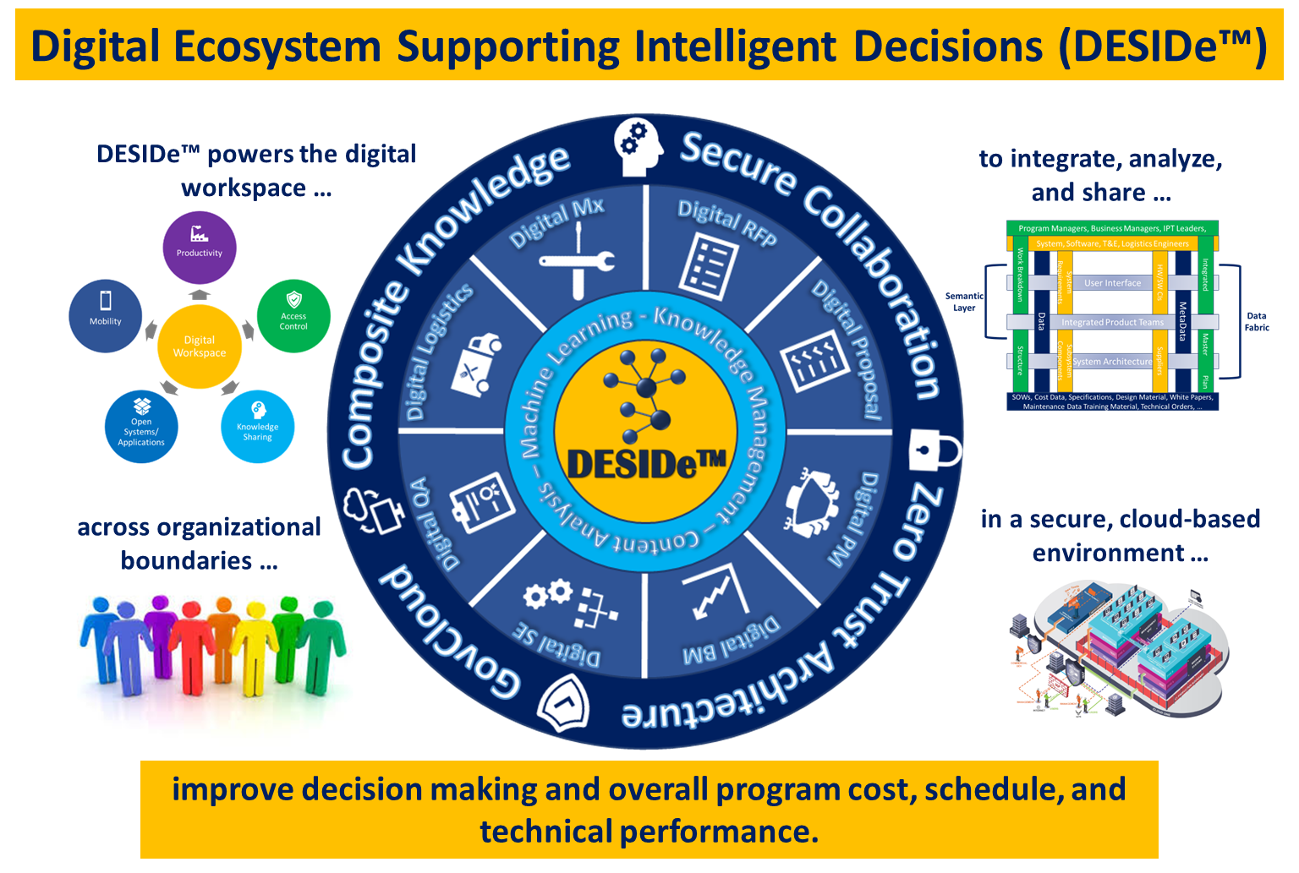
Accelerate
The BA&DT Team has developed a set of tools and applications that promote the ability of the End User to contribute information and knowledge that can be easily shared with other Users within Groups of similar interests
PEOs/Program Management Teams
System Engineering Teams
Logistics/Maintenance Organizations

Slide 9
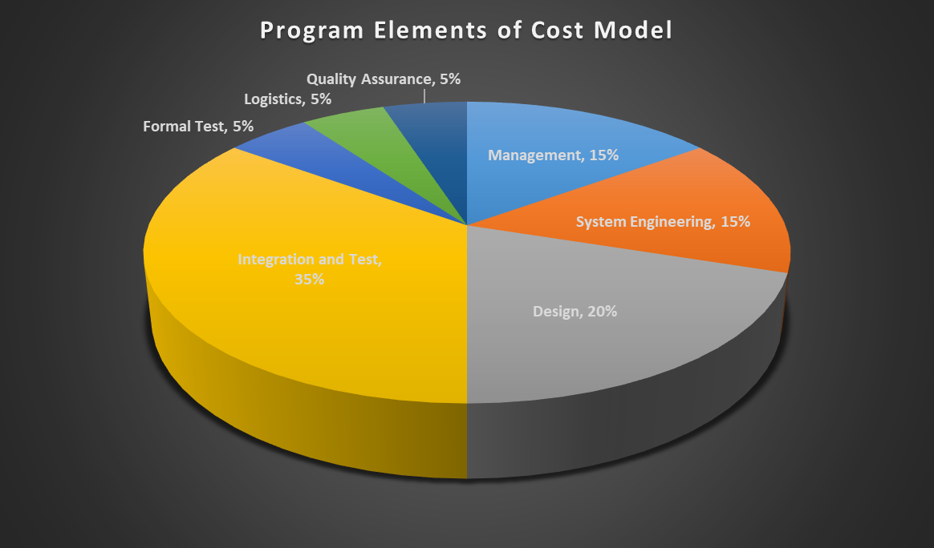
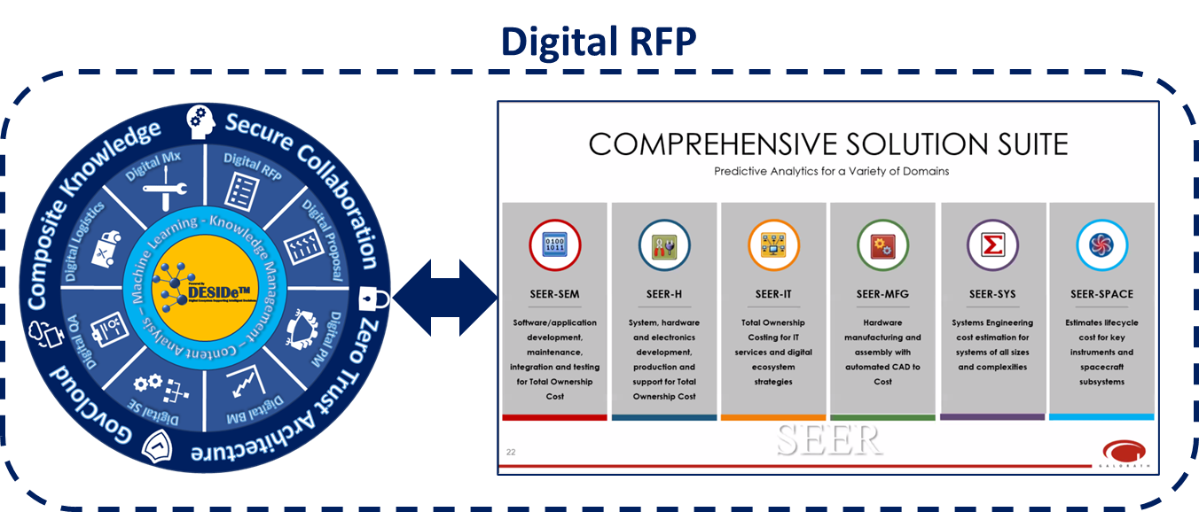
Cost
The Program/Management and Business Management functions associated with executing large DoD Programs account for ~15% of the total program cost.
However, these functions/processes have been grossly underserved by recent advancements in Digital Engineering Tools.
In addition, connecting Program Data Products (WBS, SOW, IMP/IMS, Specifications, …) to the program cost elements and associated cost models, supports improved decision-making and overall program performance.

Slide 10
Transition
The BA&DT Team is working closely with several organizations to develop transition plans to migrate elements of these Digital Applications to programs/organizations for initial evaluation …
Space Systems Integration Office (SSIO) for Digital RFP/Digital Proposal
LinQuest
DAF Digital Transformation Office (DTO) for Digital PI
DTIC/ARL – AI Simpliciter
RTCA for Digital DOs
WR-ALC for Digital Mx

Slide 11
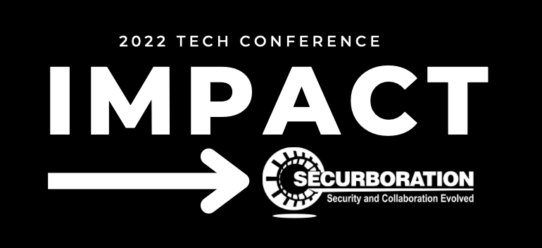
IMPACT Summary
Innovation | Leveraging latest Ontological and Semantic Analysis related technologies to address DoD Acquisition Processes, knowledge sharing, and aircraft maintenance.
Mission | Improve the quality of decision-making by DoD Acquisition Professionals in a digital world.
Performance | Improve productivity for creating DoD Acquisition related data products and performing aircraft maintenance operations.
Accelerate | Focus on developing the collaborative environment that allows the User to create content that can be easily shared with others within and across organizations.
Cost | Reduce the Cost of the DoD Acquisition process and improve program decision making across the entire Program Lifecycle.
Transition | Working closely with WR-ALC for aircraft maintenance related applications as well as DAF DTO and USSF for DoD Acquisition related applications.

