Slide 1
Notes:
General office info:
- Located in O’Fallon, IL, minutes from SAFB
- Primary customer is USTRANSCOM

Slide 2
What is our Impact?
Innovation – Advancing the state-of-the-art with cutting-edge processes and tools
Mission – Supporting the customer’s evolving mission with exceptional agility
Performance – Enabling sound decision making through rapid, accurate understanding
Acceleration – Driving automation and agility of processes for increased operational tempo
Cost – Delivering cost savings through more efficient and effective workflows
Transition – Guiding process development by pushing the envelope

Slide 3
Innovation
Cutting-edge processes and tools for data management at scale
Metadata strategies to enable data discovery over large-scale, diverse data sources
Automated mapping of diverse data sources to allow accurate master data creation
Data curation processes targeting varied use case and quality requirements
Techniques to empower discovery of data across physical store boundaries through business-focused logical queries
Advanced text analytics capabilities for natural language processing
Extraction of semantic concepts to uncover importance
Discovery of entities and relationships to establish relevance
Summarization for more rapid understanding
State-of-the-art cyber security techniques to protect enterprise assets
Correlation of user privileges with training and infraction data to create user risk scores
Proactive detection of data anomalies to discover adversarial manipulation
User access analysis to reveal scope and severity for breach investigation
Notes:
DATA MANAGEMENT –
USTRANSCOM has over 100 purpose-built systems for tracking movements of people and materials.
Systems were grown separately over time and cobbled together as needed.
Data environment is chaotic.
Securboration has worked multiple data projects focused on on-premises and cloud-based data management.
- Strategies for Enterprise Metadata and Master Data Management – on-prem strategies
- Enhanced Data Lakes – into the cloud strategies – LOCATION DATA CHALLENGE
- Knowledge Management in an Enterprise Data Environment – primarily textual, but included cross-store queries
- Automated Mapping of Diverse Data Sets – Using metadata from other efforts to provide automated matching
TEXT ANALYTICS
SES – Metatagger – TOMODACHI SITUATIONAL AWARENESS
Knowledge Management in an Enterprise Data Environment – expand Metatagger to concept extraction, entity extraction, summarization
CYBER SECURITY
Zero Trust Operational Access Control – proactive detection of insider threats and analysis of breach consequences
- INSIDER THREAT DETECTION and BREACH ANALYSIS

Slide 4
Mission
Support the customer’s evolving mission
Promote data management techniques that provide precise, discoverable information
Enable informed decision making with accurate and timely text analytics
Improve security posture with proactive cyber security approaches

Slide 5
Performance
More accurate discovery, management, and use of enterprise data across disparate stores
Sound decision making through rapid understanding of incoming text-based data feeds
Improved security posture through proactive discovery of anomalous data arising from adversarial manipulation and insider threat
Notes:
Data management – Location data challenge – data lineage recorded automatically vs NONE from manual effort
Text analytics – performance is largely a function of speed – talk about on next slide
Cyber security – ZT-OAC - more accurate picture of breach impact through more precise knowledge of user access

Slide 6
Acceleration
Accelerated data governance through more efficient data mapping and curation
Quicker understanding of text-based information, enabling swift decision making
More rapid discovery and analysis of potential insider threat risk, adversarial data manipulation, and breach scope and severity
Notes:
Data management – Location data challenge – 86 locations across 13 country codes and 3 COCOMs took one person 1.5 months manually. Automated curation took 3 people 4 months to set up, but then was able to process all 55,092 unique locations tracked by USTRANSCOM in seconds and could be reused as locations changed.
Text analytics – Tomodachi radiological incident detected up to 4 days earlier
Cyber security – Detection as a breach happens vs after effects are noticed

Slide 7
Cost
Reduction in time spent manually correlating and curating elements and attributes of heterogenous data sources
Manpower savings through automated discovery, filtering, and aggregation of text-based information
Time savings for security analysis and prevention of cost associated with improper accidental or adversarial data manipulation
Notes:
Data management - Location data challenge - Represented nearly a 99% reduction in man hours.
Text analytics – Customer estimated 2 to 4 man hours / day workload savings
Cyber security – Hard to quantify, but Equifax breach was 1.4B, log4j vulnerability still being tallied, what is the cost of national security?

Slide 8
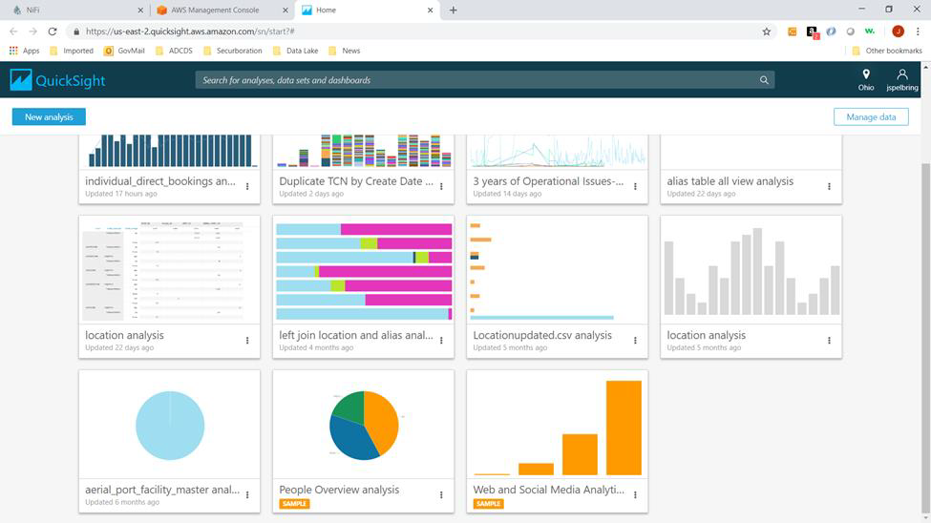
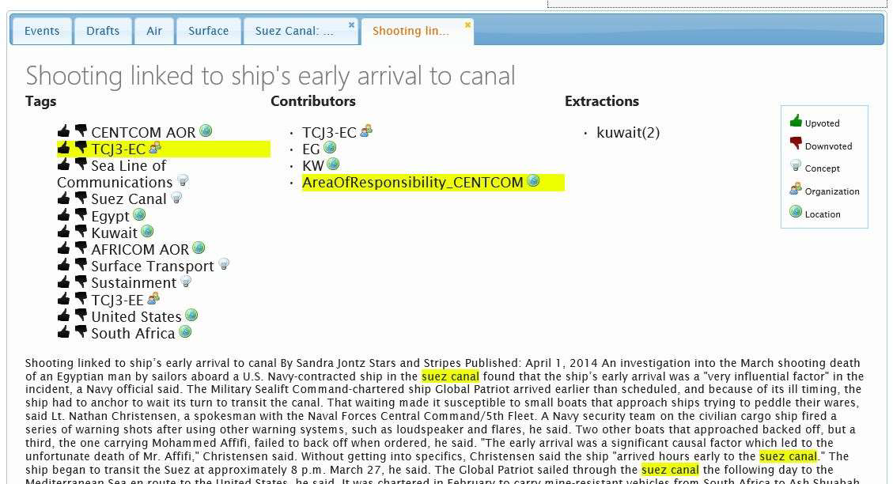
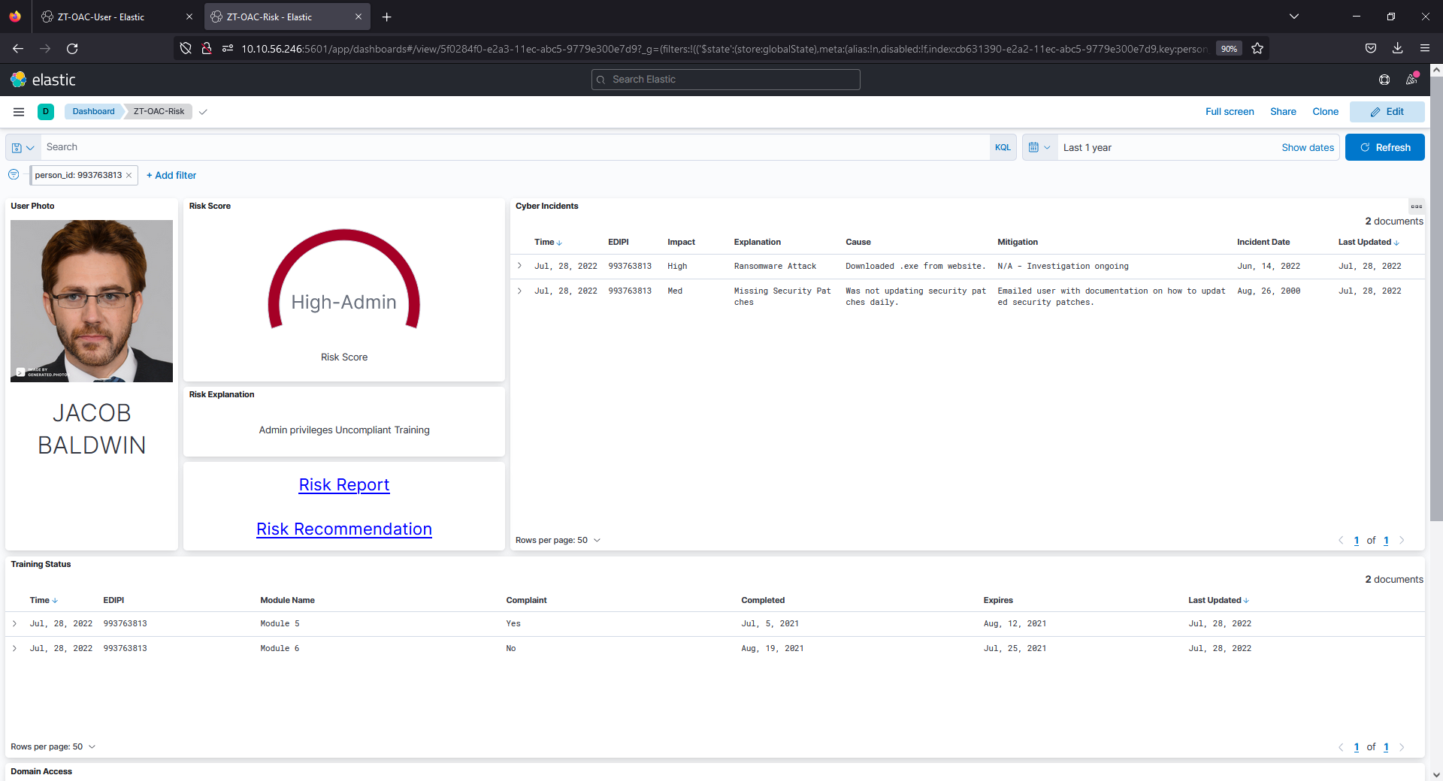
Transition
Recommended data management strategies were used to define processes for data curation and metadata management in USTRANSCOM’s data analytics environment
Text analytics microservice deployment will drive development of processes for RDT&E in Cloud One
Actively working deployment of prototype user risk analysis dashboard to GovCloud

Slide 9
I.M.P.A.C.T Summary
Innovation – Advancing the state-of-the-art with cutting-edge processes and tools
Mission – Supporting the customer’s evolving mission with exceptional agility
Performance – Enabling sound decision making through rapid, accurate understanding
Acceleration – Driving automation and agility of processes for improved operational tempo
Cost – Delivering cost savings through more efficient and effective workflows
Transition – Guiding process development by pushing the envelope

