Slide 1
Notes:
A small business based in Melbourne, Florida, Securboration Incorporated strives to make a positive impact for its customers and stakeholders, the local community, and the world. Our C2ISR, or command and control, intelligence, surveillance, and reconnaissance, Innovations line of business is focused on advancing the state-of-the-art in C2ISR to enable joint all-domain operations across the DoD, IC, and whole-of-government.

Slide 2
What our products IMPACT?
Innovation – Semantic Technologies and AI/ML to support decision making
Mission – Automate “what happened” so analysts can determine “so what”
Performance – Exceptional sense-making leading to fast, informed decisions
Accelerate – Accelerate blue’s OODA loop while slowing red’s
Cost – Faster, effective decisions at scale for the high-end fight
Transition – Working with ACC, NASIC and program offices to transition tools
Notes:
The C2ISR Innovations team has developed two product lines, one to improve battlespace understanding and decision making and another to enhance battlefield coordination and communication. This video focuses on the former which includes our Genesis family of battlespace understanding products and our DyTOPS suite of algorithms focused on enabling dynamic targeting at speed and scale.

Slide 3
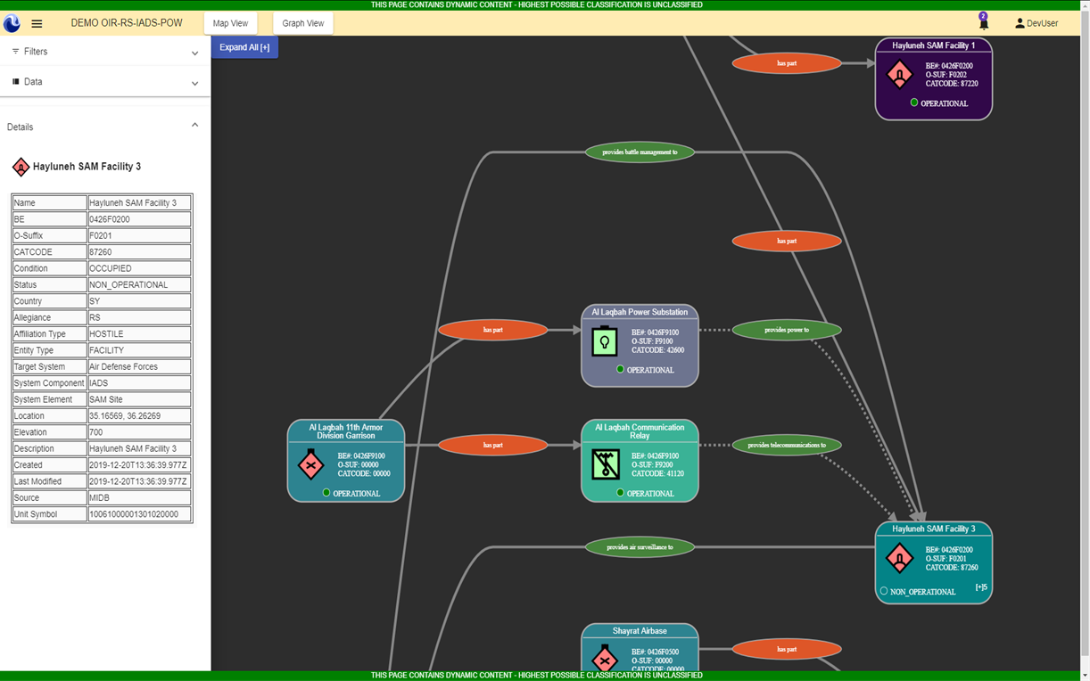
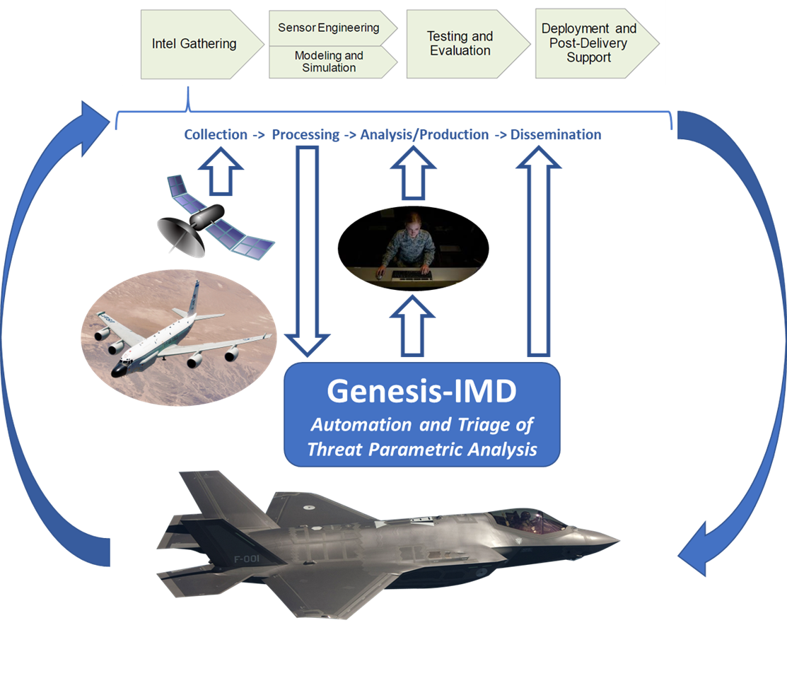
Innovation
Improving decision making by leveraging:
Semantic technologies and AI/ML techniques to support living objects
Operationalized constraint-based techniques for Dynamic Targeting at scale
Machine learning algorithms to accelerate threat characterization and mission data file production
Notes:
As the competition turns to crisis and then conflict…the speed at which decisions are needed accelerates. This increased tempo requires automation, augmentation, and artificial intelligence to process the masses of information to enable understanding and fast-paced decision making. The C2ISR Innovation team of subject matter experts, senior engineers, and developers leverages the latest AI/ML technologies with domain expertise to deliver innovative products to its customers.

Slide 4
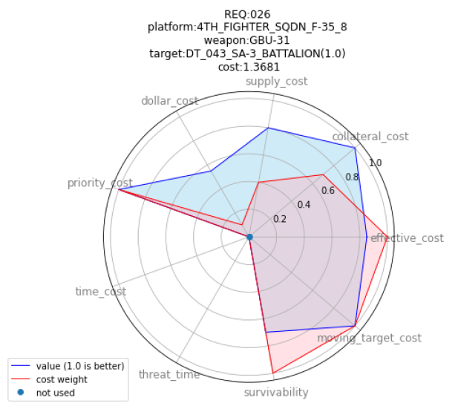
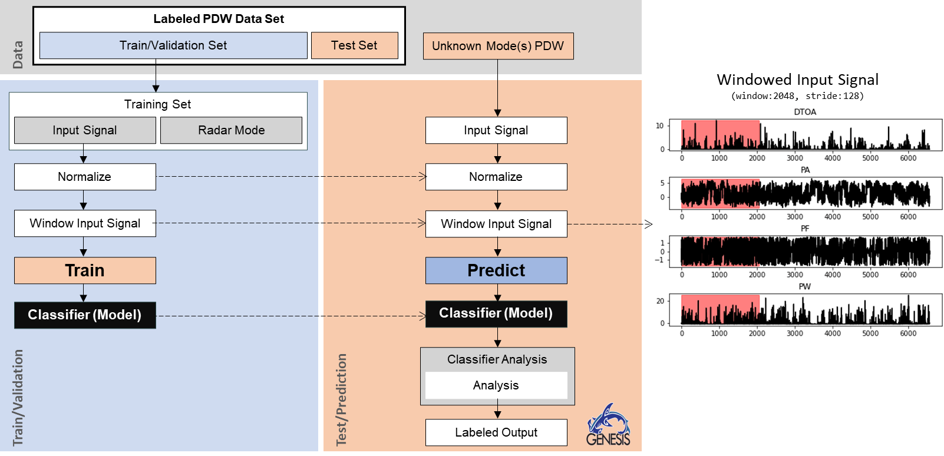
Mission
Automate “what happened” so analysts can determine “so what”
Monitoring battlespace effects through augmented object-based production
Dynamic targeting at speed and scale through optimized weapon/target pairing
Automated threat emitter characterization & analysis for accelerated MDF production
Notes:
Our Genesis products assists analysts by automating “what happened” so they can determine “so what.” Currently, analysts spend 75% of their time searching for information while only 25% of their time is spent understanding the information and battlespace impacts. The Genesis family of products enables analysts to focus on the hard problem, understanding “Why,” by automating object-based production techniques including natural language processing and other AI/ML processes to update objects and systems for greater battlespace understanding in less time.

Slide 5
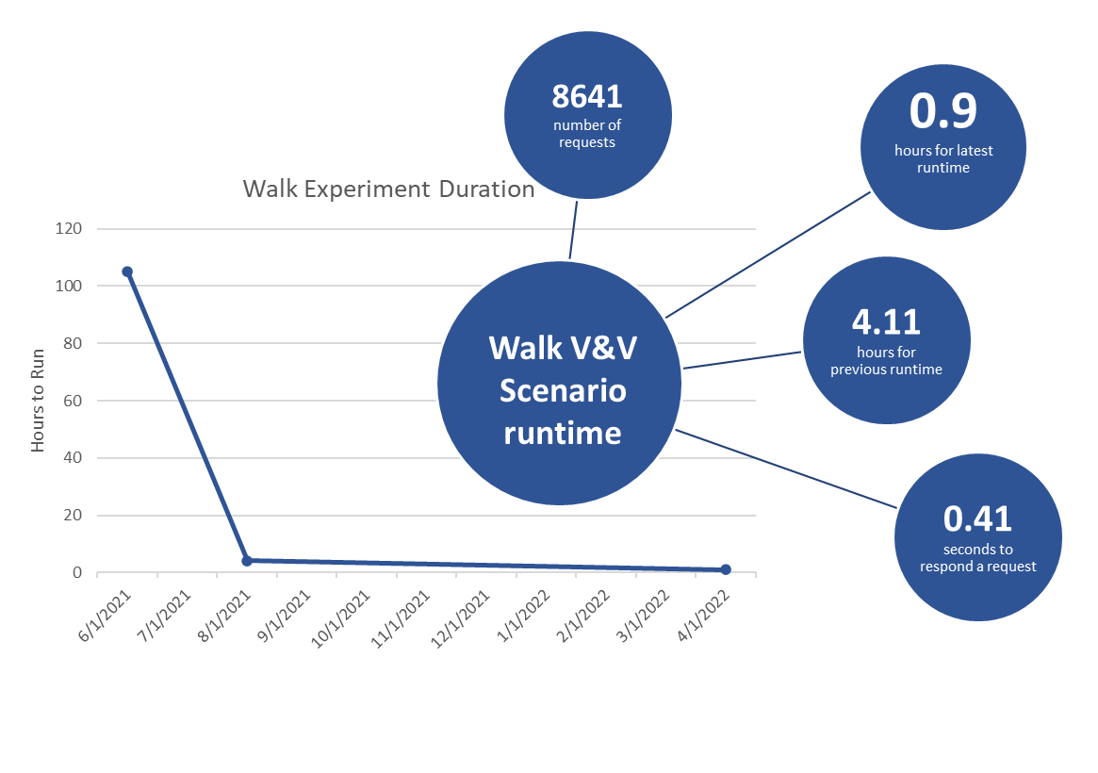
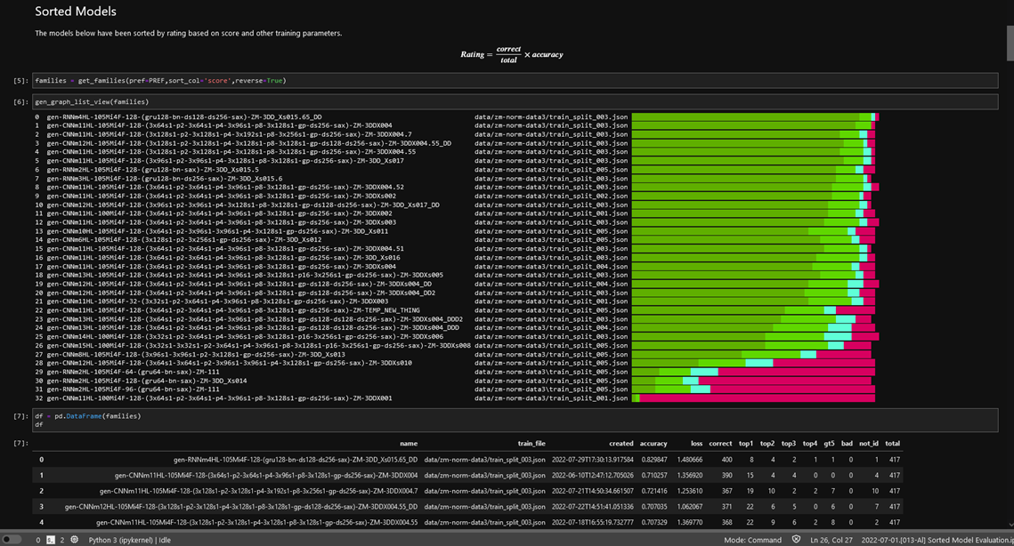
Performance
Improve operational performance through exceptional sense-making leading to speedy, informed decisions
100s of optimal weapon target pairs in seconds
95+% accuracy classifying signals
Automated OBP to reduce TSA production by 50%

Slide 6
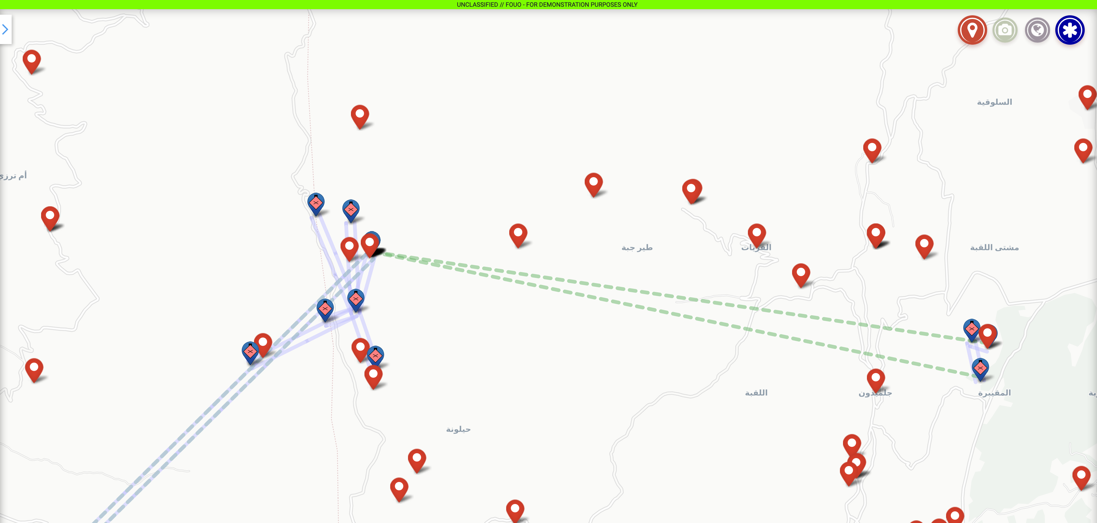
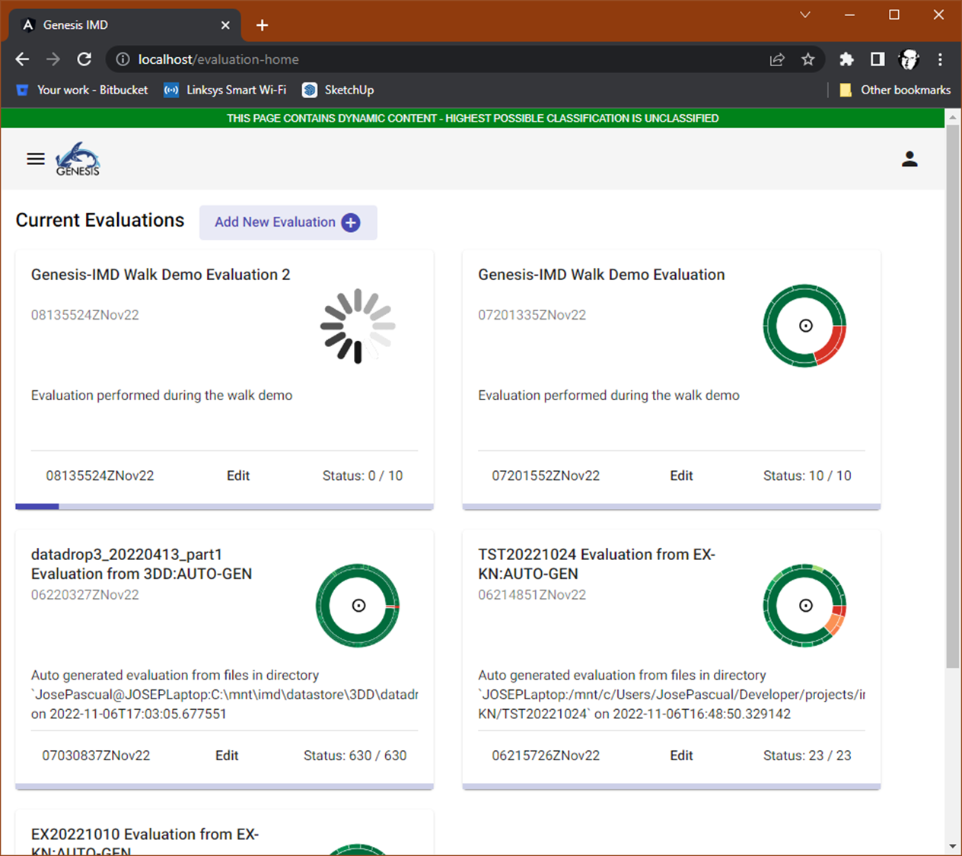
Acceleration
Accelerate blue’s OODA loop while slowing red’s
Dynamic targeting at speed and scale
Decreased time to develop EW counter measures
Increased/improved TSA production for foundational battlespace understanding

Slide 7
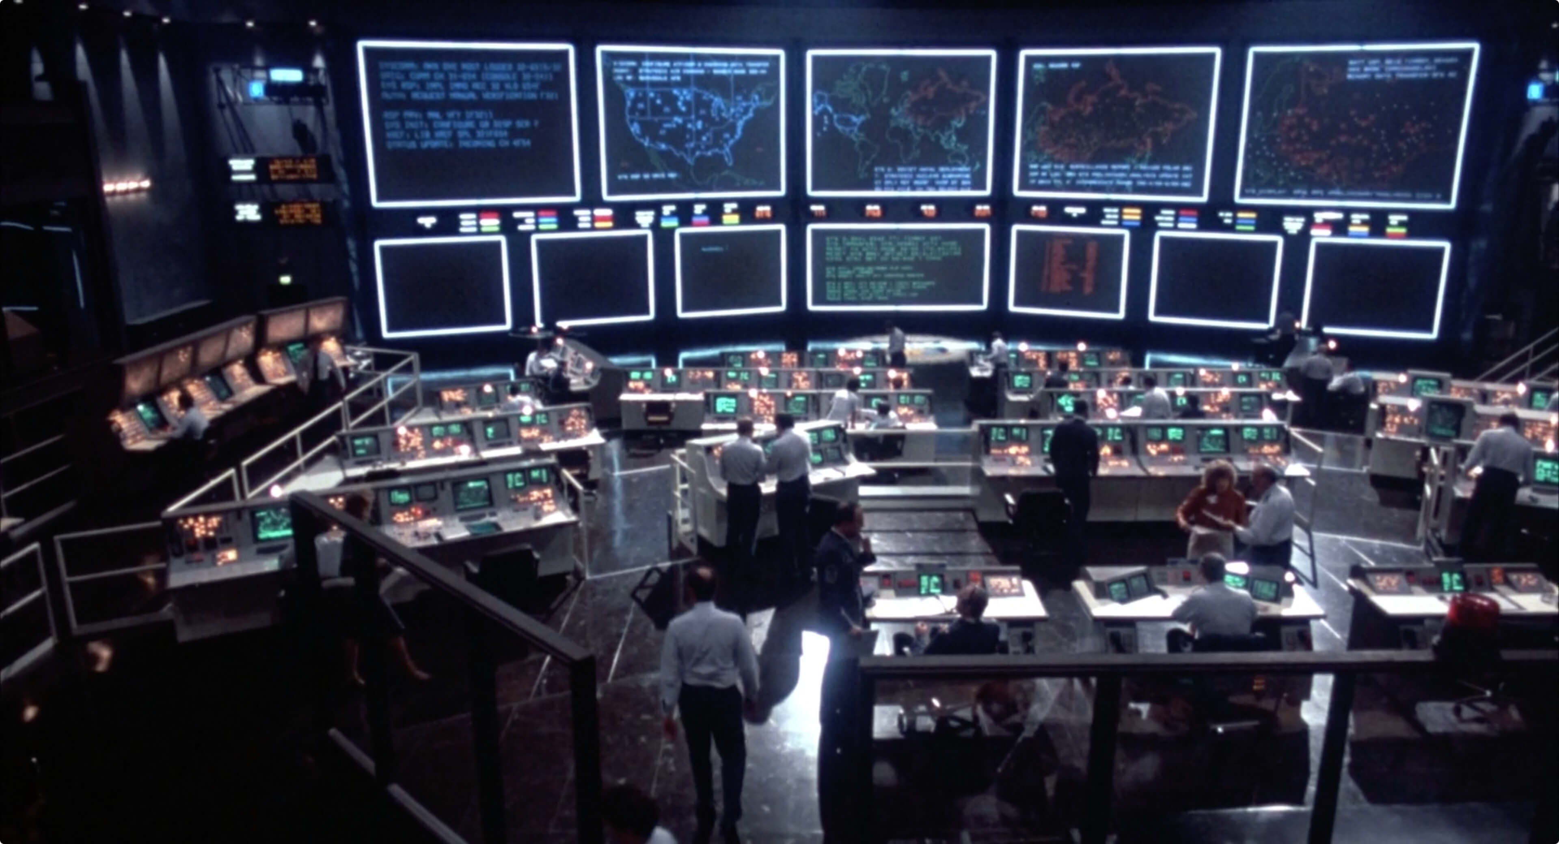
Cost
C2ISR Innovations’ products enable increased/improved/accelerated analysis, operations, & decisions by:
Automated platform/weapon-target pairing at speed/scale
Leveraging AI/ML to reduce MDF dev/update time
Effective campaigning through improved battlespace understanding

Slide 8
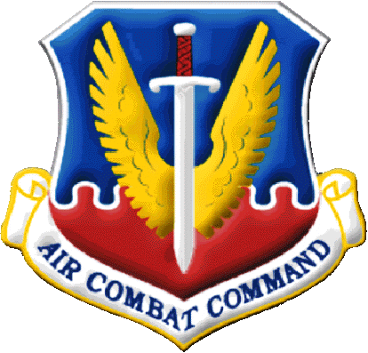
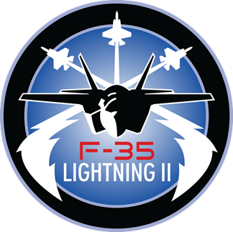
Transition
Genesis: AFLCMC, ACC/A2, and 363 ISRW
Genesis-IMD: NASIC, Other IMD Production Centers
DyTOPS: Air Operations Centers

Slide 9
I.M.P.A.C.T Summary
Innovation – Semantic Technologies and AI/ML to support decision making
Mission – Automate “what happened” so analysts can determine “so what”
Performance – Improve operational performance through exceptional sense-making leading to speedy, informed decisions
Accelerate – Accelerate blue’s OODA loop while slowing red’s
Cost – Faster, effective decisions at scale for the high-end fight
Transition – Working with ACC, NASIC and program offices to transition tools

