Slide 1
Securboration Technology Conference Operational Cyber LOB
15 Nov 2022

Slide 3
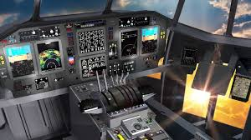
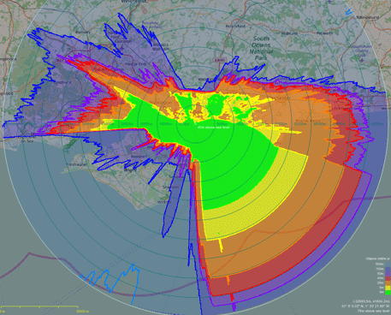
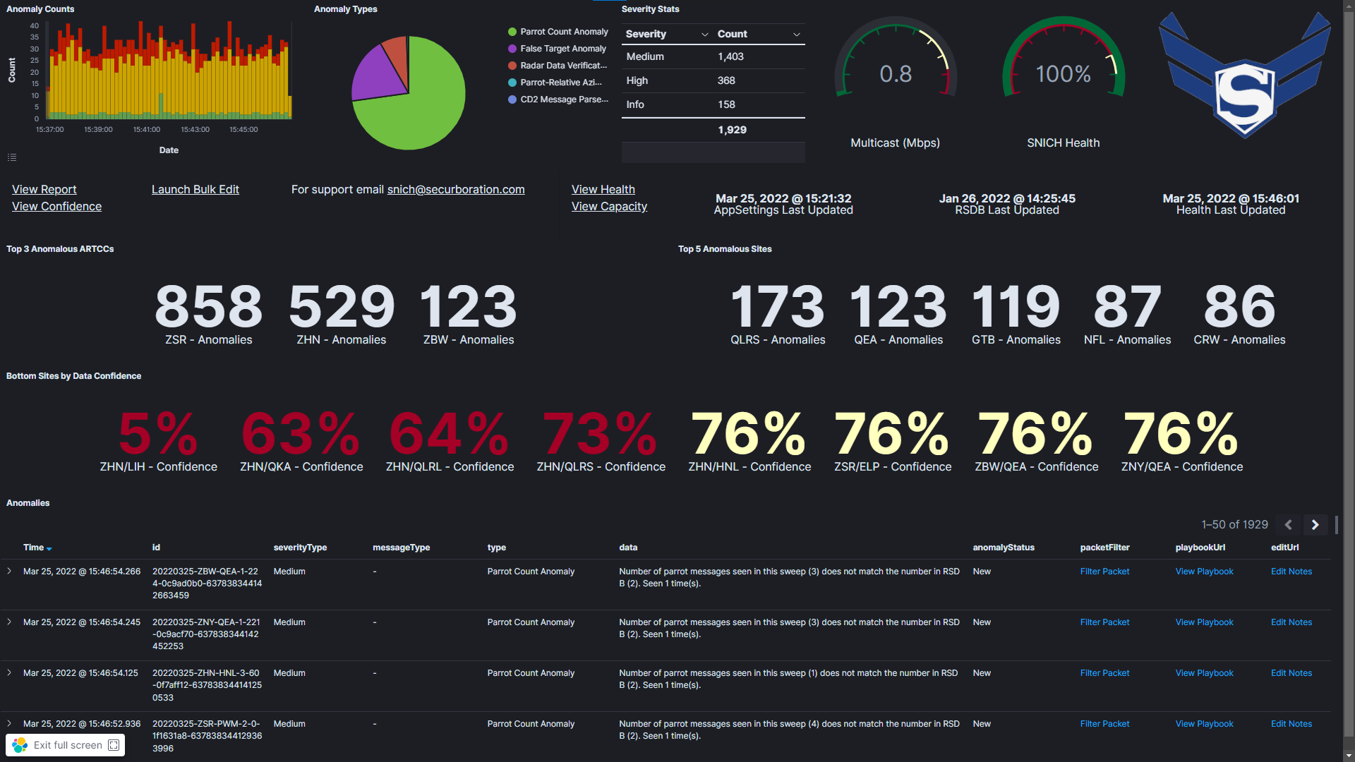
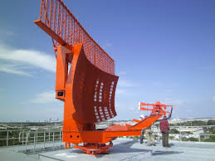
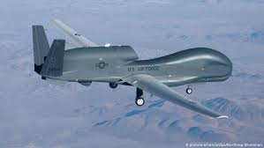
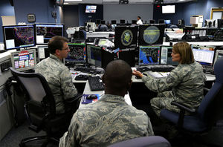
Innovation
A n o m a l y D e t e c t i o n E n g i n e
1553/429/CAN Bus
Rule Parser
Rule Based Analyzer
Tailorable
Dashboards
ML Parser
Machine Learning Analyzer
Mission
Assets
Anomaly Reporting & Alerting
Frame Parser
Malicious
Activity
Stat
Parser
Statistical Analyzer
Future Parsers
Future Analyzers
IP based streams
Cyber Playbooks
Cyber Reporting
High volume & velocity
Anomalies
Curated Data
MDTs, Platform Maintainers, Air Crews
Employs unique combination of AI/ML, statistical and domain-based rules to counter sophisticated and zero-day attack vectors
Identifies malicious data injection, removal and manipulation in real time including erroneous maintenance actions
Extensible, performant, and highly modular design for adding data streams, analyzers, and responding to dynamic threat environment
Securboration Proprietary
3

Slide 4
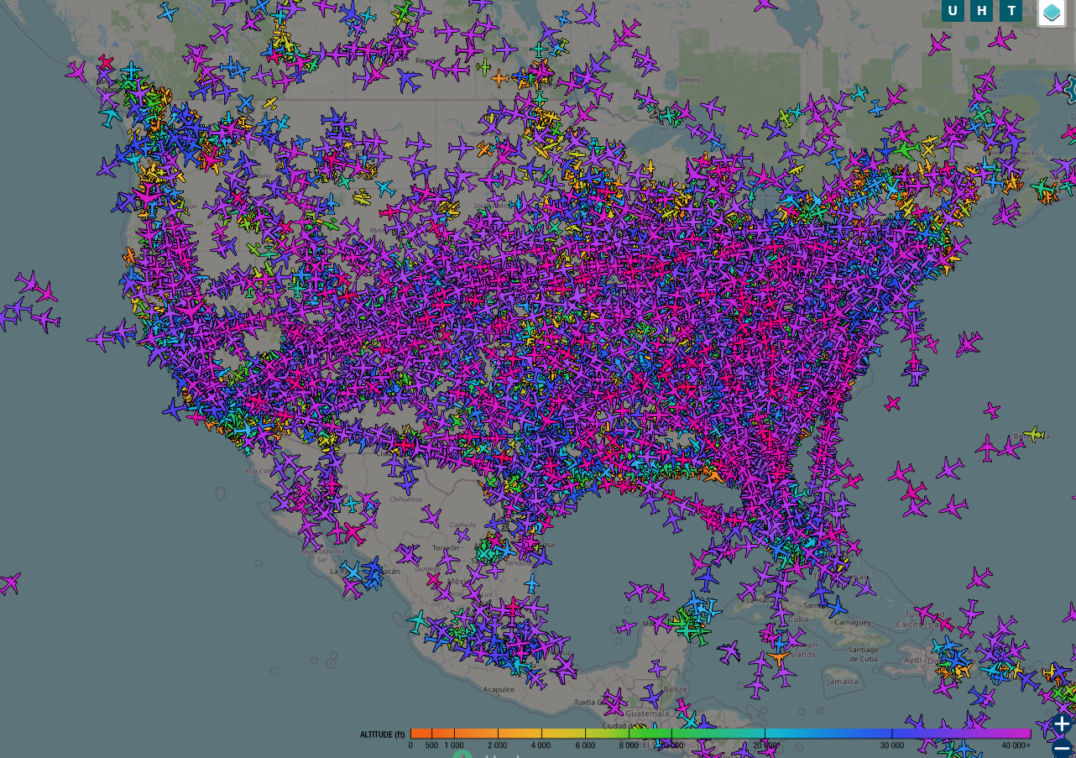
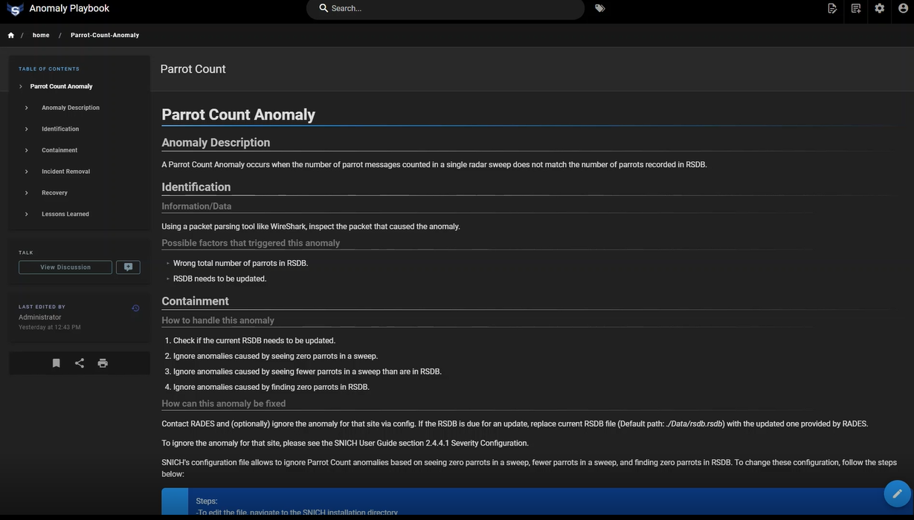
Mission
Mission Defense Teams are overwhelmed by the volume and velocity of incoming sensor data and lack the cognitive bandwidth to identity adversary attempts to subvert and distract operators and divert limited valuable assets (both operator and aircraft)
Securboration provides MDTs with the necessary defensive cyber tools to counter adversarial deception and ensure information confidence and mission resiliency
Low
probability
Cyber Playbooks
“One of our greatest concerns is adversaries manipulating the data to manipulate operator decision on that data”,
SNICH Customer

Slide 5
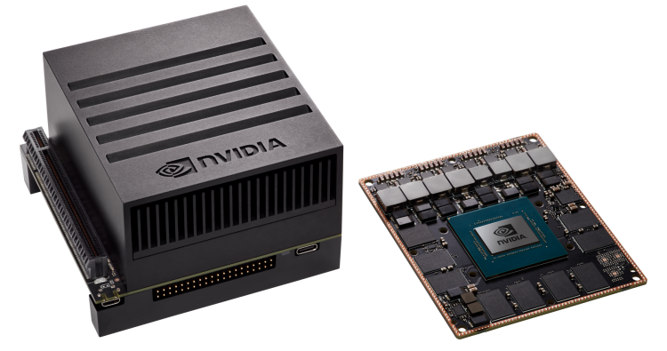
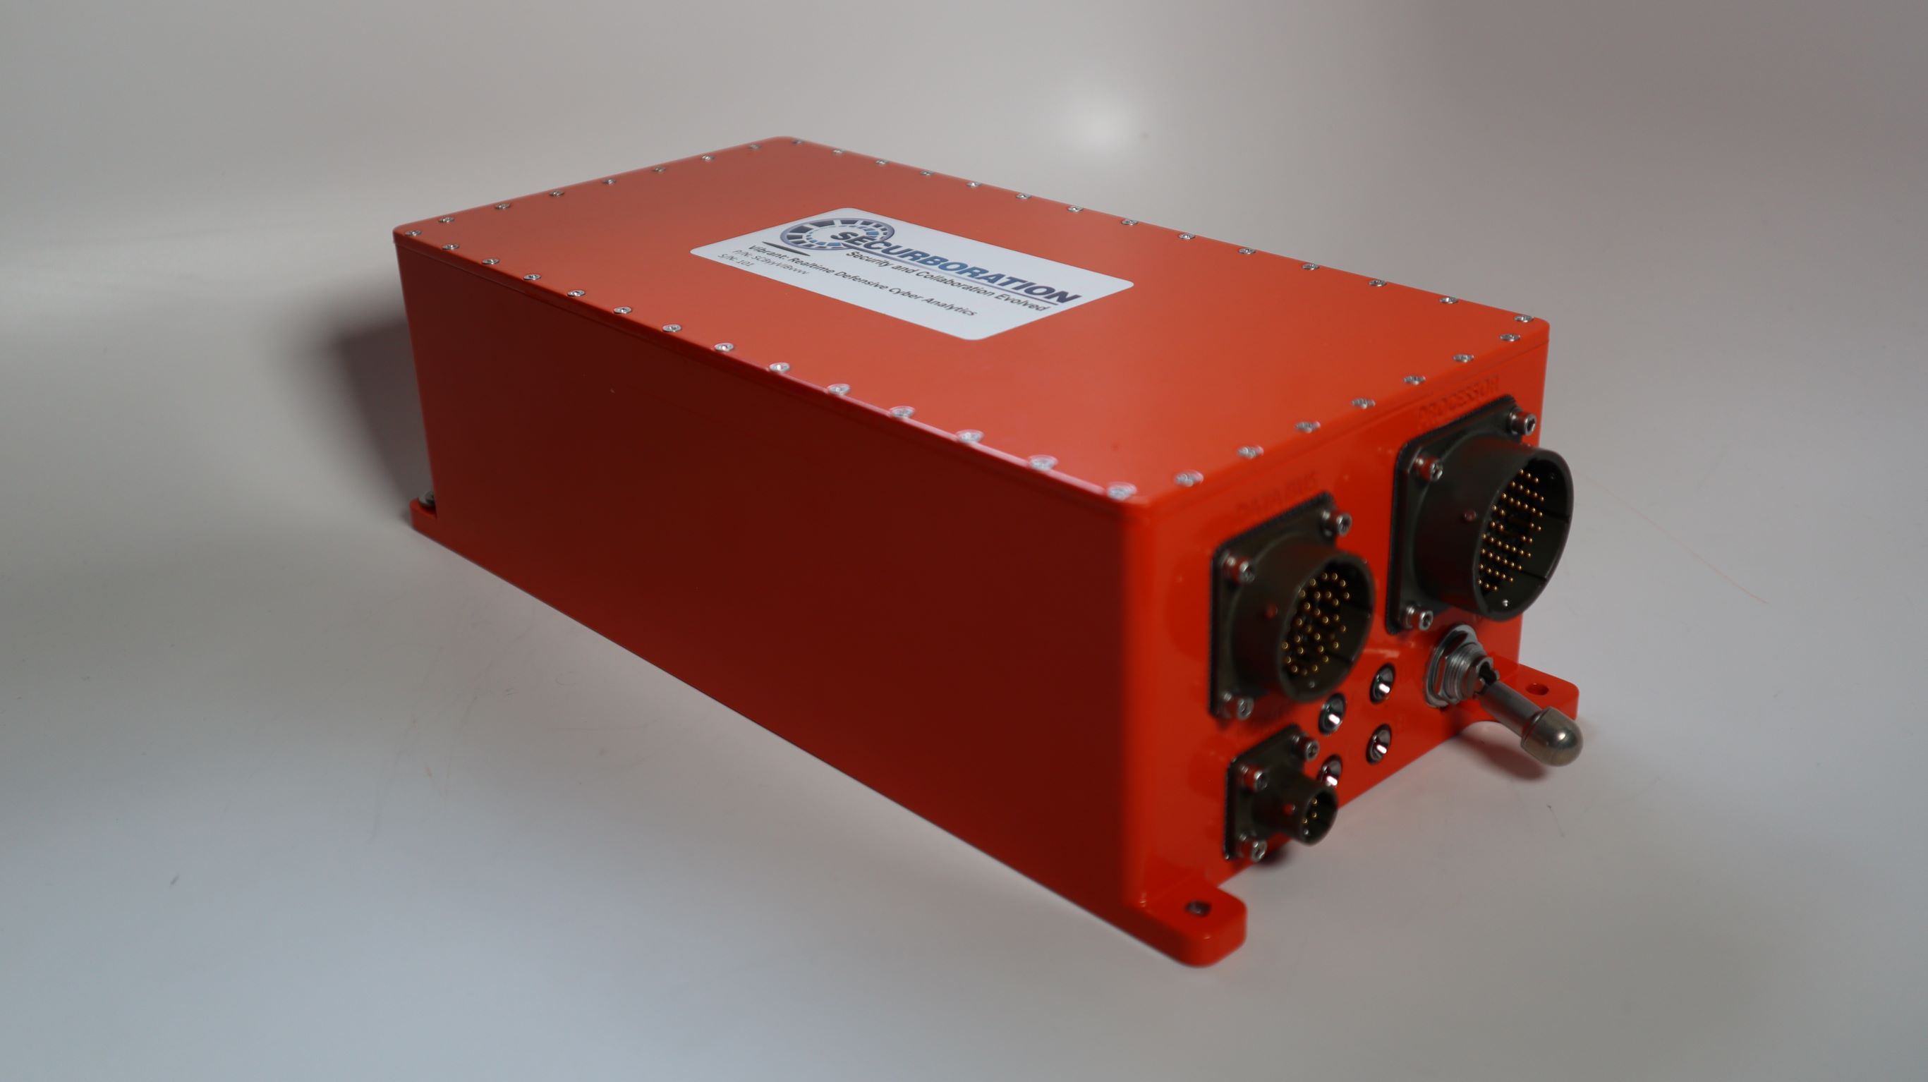
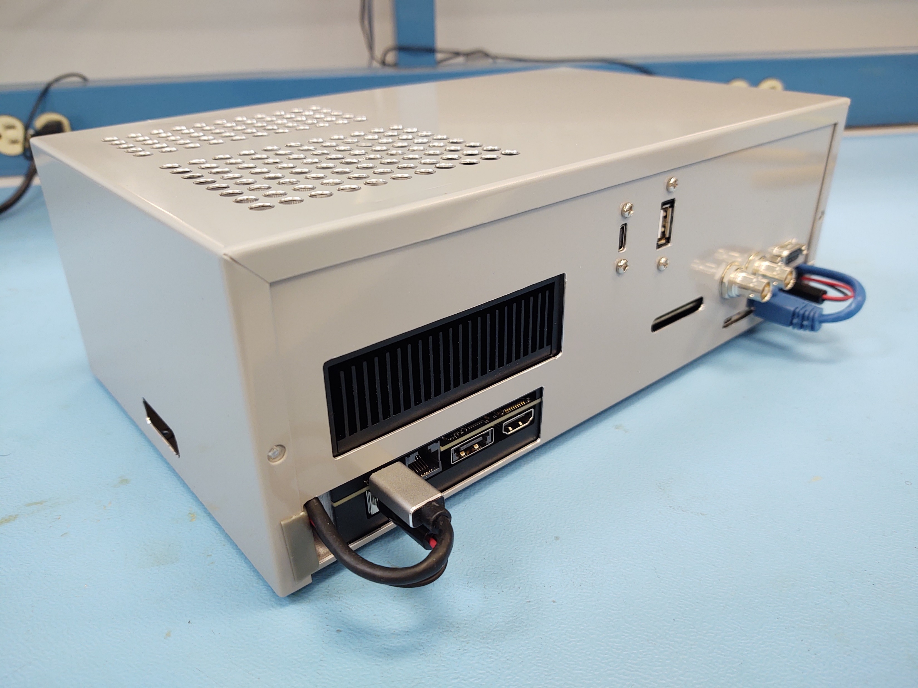
Performance
Passively monitors mission critical data streams for cyber intrusion without increasing latency of existing information flows
Purpose built multi threaded architecture continues operation during data surges and DOS style attacks; 330+ sensors, 10k packets/sec, 70+ anomaly types
Enables time-critical mission decisions and dramatically enhance the ability of mission defense teams, and their commanders
MIL-STD-810G
Benchtop Version
Octal-core NVIDIA Carmel ARMv8.2 CPU @ 2.26GHz
512-core Volta GPU @ with 64 Tensor Cores
Dual Deep Learning Accelerator (DLA) engines
32GB 256-bit LPDDR4x @ 2133MHz (137GB/s)
32GB eMMC 5.1
Vision Accelerator engine
(4x) 4Kp60 H.264/H.265 video encoder
(2x) 8Kp30 / (6x) 4Kp60 H.265 video decoder
Weight with lid ~6.2lbs.
Dimensions - 11.2" x 5" x 3.375"
Power Draw – maximum seen is </= 1.5A @ 28VDC.

Slide 6
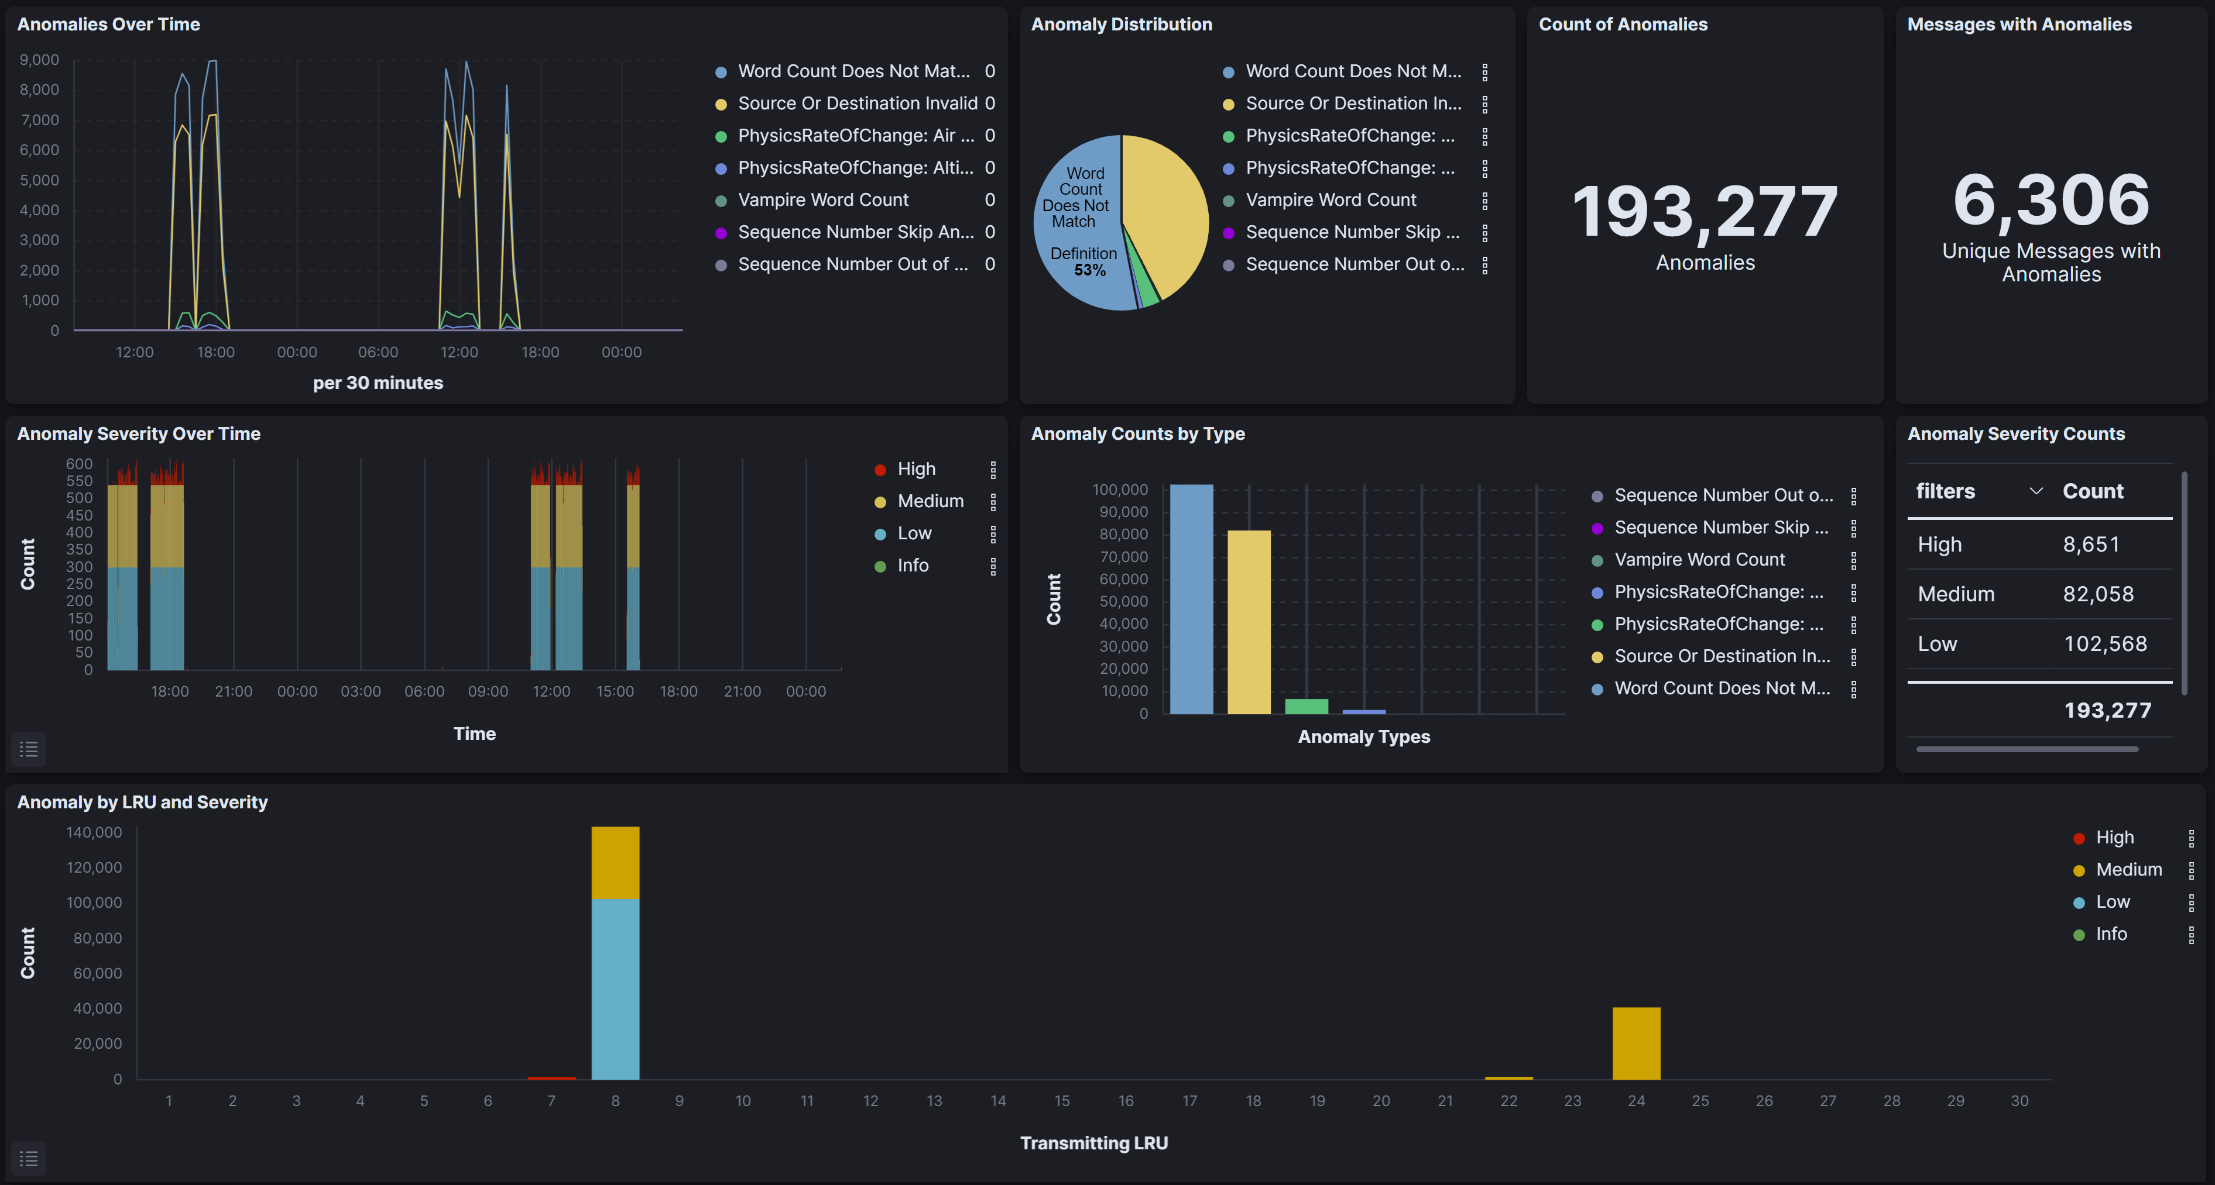
Accelerate
Rapidly create dashboards and analyzers for MDT, maintainers, and decision makers
Web based user interface; Cloud based deployments; Machine-to-Machine API

Slide 7
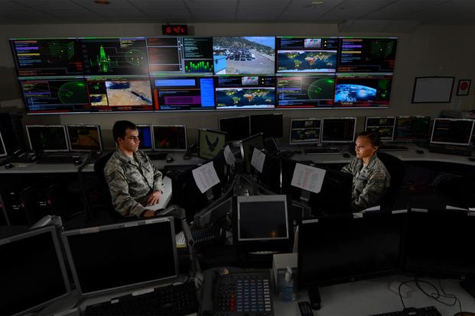
Cost
User organizations leverage multi million-dollar DoD investment which has been tested, certified, and deployed
The projected cost savings can be measured in terms of lives and resources saved resulting from accelerated response times, TTPs and circumvention of committing limited resources (manpower, equipment, money, etc.) based on nefarious data
Increase scope of mission monitoring with fewer resources and in less time == Early cyber event warning and mitigation

Slide 8
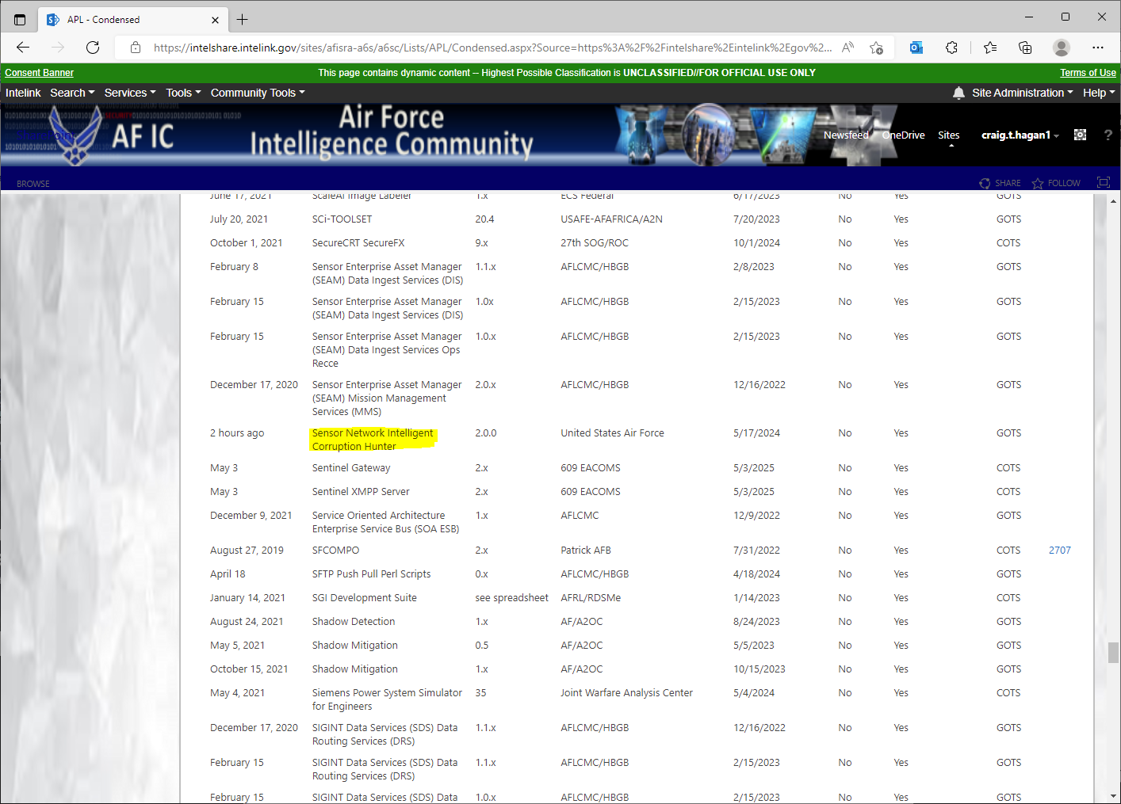
Transition
On 21 August 2020, Securboration Inc, with support from the Air Force Research Laboratory (AFRL) Rome Research Site, successfully deployed SNICH at the NORAD’s Eastern Air Defense Sector (EADS) in Rome, New York.
Since SNICH’s initial deployment, EADS has received numerous enhancements and the software has been deployed to the Western Air Defense Sector (WADS) at Joint Base Lewis-McChord, WA and the FAA Technical Center, Egg Harbor Township, NJ.
The technology has undergone numerous engineering tests, security scans and the Defense Accounting Office (DAO) has issued a Certificate to Field (CTF) for SNICH allowing government organizations to install the software on their network.

